Slide 1
Personal Assignment 1
Mobile App Programming
Spring, 2021
Notes:
OK, Let’s start the first lecture of Mobile App Programming course. I’m your TA Lee Seongho .

Slide 2
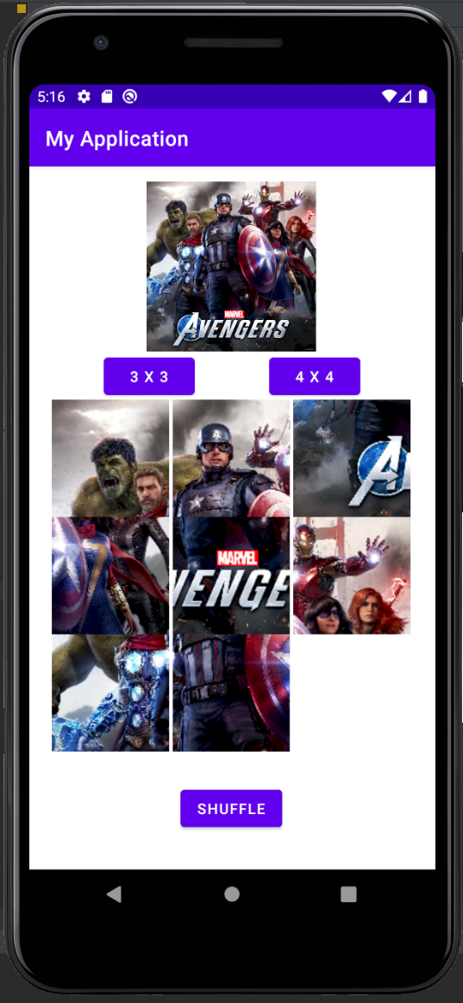
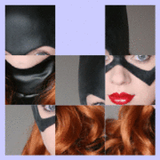
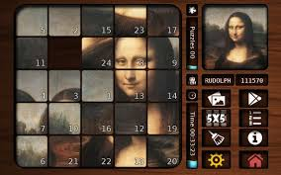
Personal Assignment 1 : Sliding Puzzle
- Goal : you should make sliding puzzle(8-puzzle, 15-puzzle) game using Android Studio.
- Before implementation, please watch PA1 video on ICAMPUS.
https://en.wikipedia.org/wiki/15_puzzle
Notes:
In this semester, you may meet four different TAs, including me.
We are all belonging to Computer Network laboratory, which is located in Cooperation and Collaboration Center.
And like other courses do, we run the google sheet for Q&A. So, if you have a question, freely write on that sheet. We try to answer you ASAP.

Slide 3
Before you start PA1…
There are many ways to implement this assignment, you can use anything you want.
We will check copy thoroughly. If you cheat, you will get 0 point or ‘F’ grade.
You don’t have to think about design(space, color, etc.,) of application. If it works well at Pixel 3a phone, you will get full points.
In PA1, you need to google how to use some views which we didn’t learn in class (such as gridView, BitampFactory …)
After extract your project to .zip file, submit it on ICAMPUS.
Minimum sdk is API 16, we test on AVD with API 29.
Notes:
There’re four parts for your grades. 10% for Attendance, 20% for Lab practice, 30% for 2 individual Assignment (it means that 15% for each. ) and 40% for team project.
I will check your attendance 15 minutes later after the class is stared, so after 15 minutes you will get lateness, and You will get F grades, when you absent more than 4 times.
And every week I’ll give you a simple exercise, called lab practice. So you have to submit this exercise until the midnight.
We have two individual assignments, but we still discuss about assignments contents, so it will be announced later.
The last thing is team project.

Slide 4
Main Activity component
Main Activity has 1 image view, 3 buttons, and puzzle board.
Original Image : you should show answer image at the top of display.
Button 1 (3X3) : If you click this button, puzzle should change to 3X3 with initial state.
Button 2 (4X4) : If you click this button, puzzle should change to 4X4 with initial state.
Button 3 (Shuffle) : If you click this button, puzzle should be shuffled randomly.
Puzzle board : we recommend to implement this using GridView. But you can use any other ways such as Grid Layout, Image buttons, etc,.
Notes:
There’re four parts for your grades. 10% for Attendance, 20% for Lab practice, 30% for 2 individual Assignment (it means that 15% for each. ) and 40% for team project.
I will check your attendance 15 minutes later after the class is stared, so after 15 minutes you will get lateness, and You will get F grades, when you absent more than 4 times.
And every week I’ll give you a simple exercise, called lab practice. So you have to submit this exercise until the midnight.
We have two individual assignments, but we still discuss about assignments contents, so it will be announced later.
The last thing is team project.

Slide 5
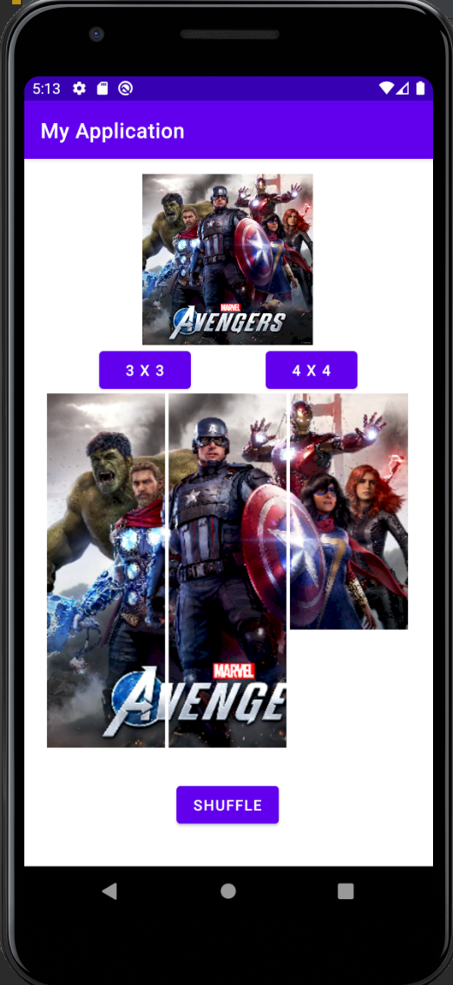
App component 1 : Original Image
Original Image
Your app should show original answer image using ImageView.
You can use any images which satisfy below constraint.
1:1 width-height ratio images.
All puzzles should be different.

Slide 6
App component 2 : 3X3 button
2. 3X3 button
If you click this button, you puzzle board change to 3X3 puzzle(8-puzzle) with initial state.
Initial state : remove 9th puzzle(3,3) at original image.

Slide 7
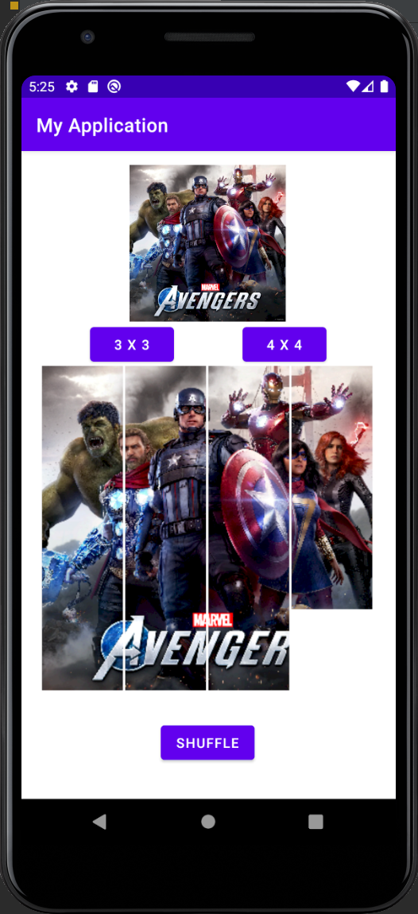
App component 3 : 4X4 button
3. 4X4 button
If you click this button, you puzzle board change to 4X4 puzzle(15-puzzle) with initial state.
Initial state : remove 16th puzzle(4,4) at original image.

Slide 8
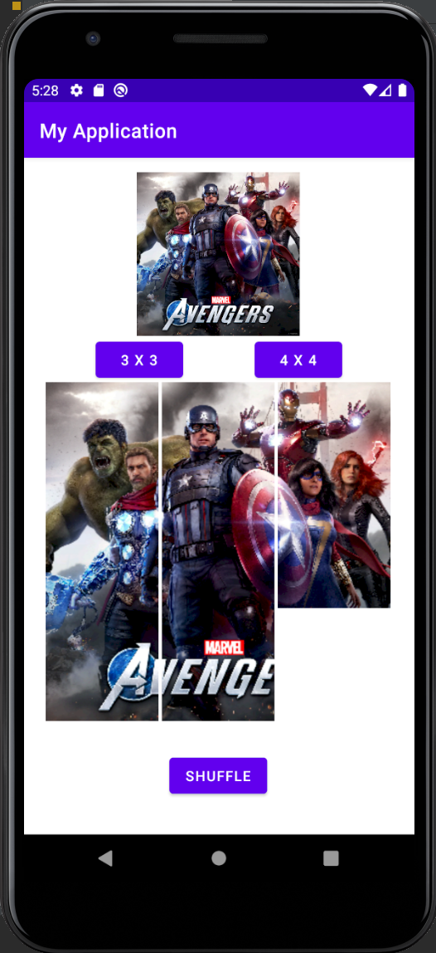
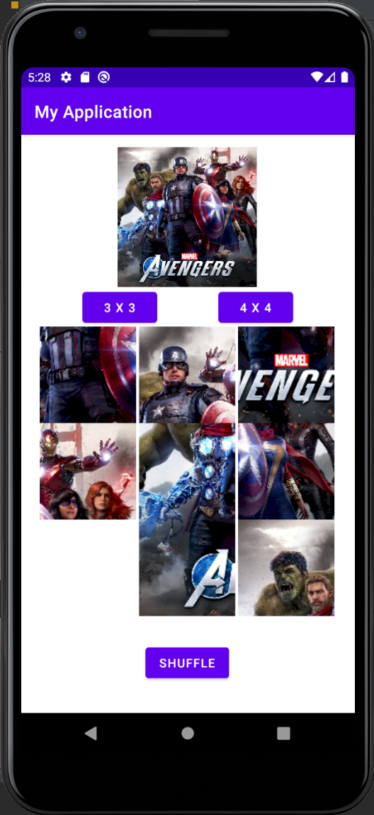
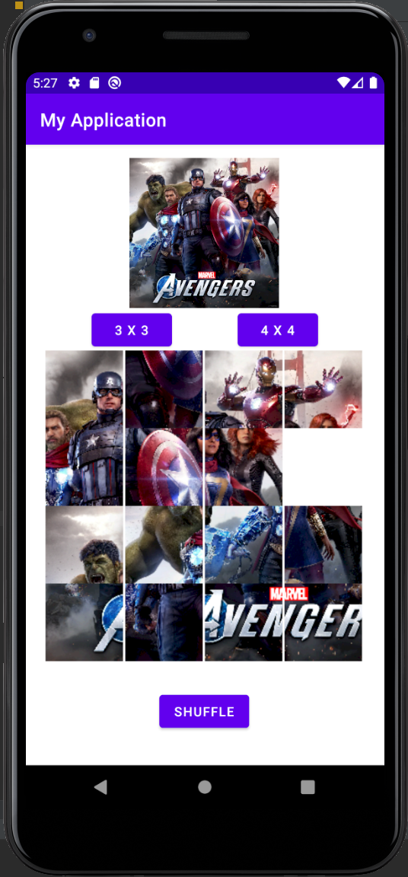
App component 4 : Shuffle button
4. Shuffle button
If you click this button, your puzzle should be shuffled randomly.

Slide 9
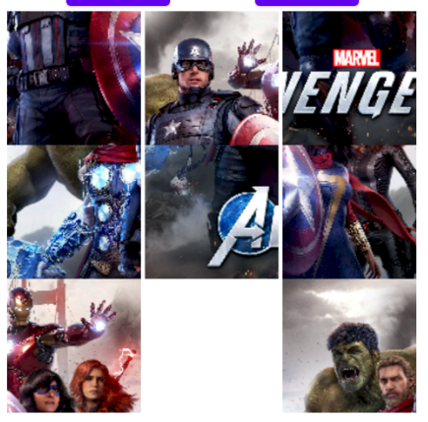
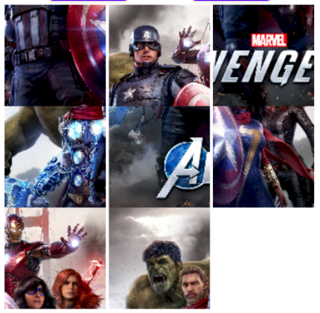
App component 5 : Puzzle board
5. Puzzle board
There is 1 white puzzle at (3,3) or (4,4)
When you click movable puzzles (left, right, above, below of white puzzle), change position with a white puzzle.
When you click non-movable puzzles, ignore it.
When you complete puzzle (being initial state), app should toast message “FINISH!” with long term option.
click
click

Slide 10
Grading Policy
Basic Layout (20 pt)
If you show all component properly, you will get default points.
1 error is -5 points
3X3 button (10 pt) – no partial points
4X4 button (10 pt) – no partial points
Shuffle button (10 pt) – no partial points
Grid View (50pt)
Puzzles move properly at 3X3 puzzle (20 pt)
Puzzles move properly at 4X4 puzzle (20 pt)
Check End state well and print toast message (10pt)
Total 100 points
Notes:
There’re four parts for your grades. 10% for Attendance, 20% for Lab practice, 30% for 2 individual Assignment (it means that 15% for each. ) and 40% for team project.
I will check your attendance 15 minutes later after the class is stared, so after 15 minutes you will get lateness, and You will get F grades, when you absent more than 4 times.
And every week I’ll give you a simple exercise, called lab practice. So you have to submit this exercise until the midnight.
We have two individual assignments, but we still discuss about assignments contents, so it will be announced later.
The last thing is team project.

Slide 11
Challenging points with tips
In this personal Assignment, there is 3 challenging points.
1. Image division -> BitmapFactory, Bitmap, etc.
2. Puzzle board -> GridView, GridLayout, ImageButtons, etc.
3. Puzzle move -> onItemClickListner(), etc.
Helpful reference page. https://developer.android.com/reference/android/graphics/BitmapFactory
https://developer.android.com/reference/android/widget/GridView
https://www.geeksforgeeks.org/gridview-using-baseadapter-in-android-with-example/
https://developer.android.com/topic/performance/graphics/load-bitmap?hl=ko
Notes:
There’re four parts for your grades. 10% for Attendance, 20% for Lab practice, 30% for 2 individual Assignment (it means that 15% for each. ) and 40% for team project.
I will check your attendance 15 minutes later after the class is stared, so after 15 minutes you will get lateness, and You will get F grades, when you absent more than 4 times.
And every week I’ll give you a simple exercise, called lab practice. So you have to submit this exercise until the midnight.
We have two individual assignments, but we still discuss about assignments contents, so it will be announced later.
The last thing is team project.

